Slide 1
Intro to the Digital SAT
Overview of Test Structure and General Test-Taking Tips Joshua West

Slide 2
Time & Flow
Time: ~1 hour
Flow:
Introduction, Test Structure, and Scoring
Detailed Breakdown of Reading & Writing and Math
Testing Edge Strategy with FUEL
Conclusion and Wrap-Up
Notes:
Total target: ~60 minutes - Part 1: 15 minutes - Part 2: 25 minutes - Part 3: 15 minutes - Part 4: 5 minutes

Slide 3
Part 1: Introduction, Test Structure, and Scoring
Time: 15 minutes
Notes:
Part 1 pacing: ~15 minutes total.

Slide 4

Notes:
Set the tone and explain outcomes in < 60 seconds.

Slide 5
Goals of the SAT
The SAT measures college readiness.
Used by colleges for admissions, scholarships, and course placement.

Slide 6
Raw Scores & Timing
No penalty for wrong answers.
R&W: 22 required for harder 2nd R&W section
Math: 17 required for harder 2nd Math section
Timing: 64 min for Reading & Writing, 70 min for Math.
Section Breakdown:
Section | Modules | Questions | Time
Reading & Writing | 2 | 54 | 64m
Math | 2 | 44 | 70m
Total | 4 | 98 | 134m

Slide 7
Adaptive Structure
Module 1: Same baseline difficulty for everyone.
Module 2: Adapts based on Module 1 performance.
Goal: Challenge appropriately and measure skills accurately.

Slide 8
Scoring: IRT & Equating
Item Response Theory (IRT): Accounts for question difficulty when scoring.
Equating: Ensures fairness across test forms.
Conversion: Raw score → Scaled score → Final SAT score.

Slide 9
Preparation Tips
Simulate real exam conditions with full-length tests.
Use time-blocking (e.g., Pomodoros) for focused practice.
Keep a Reflection Log to track mistakes, patterns, and fixes.
Reflection Log
Date | Section | Q# | Question Type | Why it happened | Fix / Strategy
10/15 | R&W | 12 | Inference | Skimmed evidence | Slow down, underline clues

Slide 10
Quiz 1 — Check Understanding
What is the SAT designed to measure?
How many questions are in the Reading & Writing section?
What happens in the second module of the adaptive test?
How does IRT affect your score?
Why is equating used in SAT scoring?
Notes:
Answers: 1) College readiness / skills for higher ed 2) 54 3) Difficulty adapts based on Module 1 performance 4) Adjusts scoring based on question difficulty 5) Ensures fairness across versions

Slide 11
Part 2: Detailed Breakdown of Reading & Writing and Math
Time: 25 minutes
Notes:
Part 2 pacing: ~25 minutes total.

Slide 12
General Strategies (All Sections)
Pace Yourself: Don’t over-invest in one question.
POE (Process of Elimination): Remove clearly wrong choices.
Answer Every Question: No penalty for guessing.
Revisit Flagged Items: If time remains, return and verify.

Slide 13
Core Strategies: Reading & Writing
Read Actively: Annotate, underline key terms, margin notes.
Evidence-Based Thinking: Support answers with text evidence.
Author’s Purpose & Tone: Guide main idea and inference Qs.
Words in Context: Infer meaning from usage.
Avoid Assumptions: Stick to the text.

Slide 14
R&W: Information & Ideas
Central Ideas: Identify main ideas + supports.
Command of Evidence: Locate supporting lines.
Inferences: Draw logical conclusions.

Slide 15
R&W: Craft & Structure
Words in Context: Function/meaning in passage.
Text Structure: Cause–effect, compare–contrast, etc.
Cross-Text Comparisons: Relate ideas across passages.

Slide 16
R&W: Expression of Ideas
Rhetorical Synthesis: Improve clarity, tone, logic.
Transitions: Smooth connections between ideas.

Slide 17
R&W: Standard English Conventions
Punctuation: Sentence boundaries, clarity.
Grammar: Structure, agreement, tense, parallelism.

Slide 18
Core Strategies: Math
Write Out Your Work: Reduce careless errors.
Use Estimation: Rule out implausible answers.
Check Your Work: Ensure it fits the context.

Slide 19
Math: Algebra
Linear Equations (1 var)
Systems of Equations
Inequalities (solve/graph)

Slide 20
Math: Advanced Math
Nonlinear Functions: Quadratic, exponential, polynomial.
Equivalent Expressions: Simplify/manipulate forms.

Slide 21
Math: Problem Solving & Data Analysis
Ratios & Proportions (rates, unit conversions)
Probability & Statistics (interpret & compute)
One-Variable Data: mean/median/mode
Two-Variable Data: scatterplots, regression lines

Slide 22
Math: Geometry & Trigonometry
Area & Volume (2D/3D)
Right Triangles: Pythagorean, trig ratios
Circles: angles, arcs, sectors

Slide 23
Quiz 2 — Check Understanding
In the Reading & Writing section, what does “Command of Evidence” require you to do?
For Words in Context questions, what’s the most reliable first step?
In Expression of Ideas items, what’s the main purpose of adding or refining transitions?
In the Math section, what is an efficient strategy for solving a system of linear equations?
In Problem Solving & Data Analysis, what is the correct formula for percent change?
Notes:
Answers: 1) Identify the specific lines/details in the passage that directly support your answer. 2) Read the full sentence and nearby lines to determine the word’s meaning from context—then choose the meaning that fits the passage’s tone and purpose. 3) To make relationships between ideas explicit—e.g., cause, contrast, sequence—so the paragraph flows logically. 4) Use substitution or elimination to isolate one variable, solve, then back-substitute and check the solution in both equations. 5) (new − old) ÷ old × 100%

Slide 24
Part 3: Testing Edge Strategy with FUEL
Time: 15 minutes
Notes:
Part 3 pacing: ~15 minutes total.

Slide 25
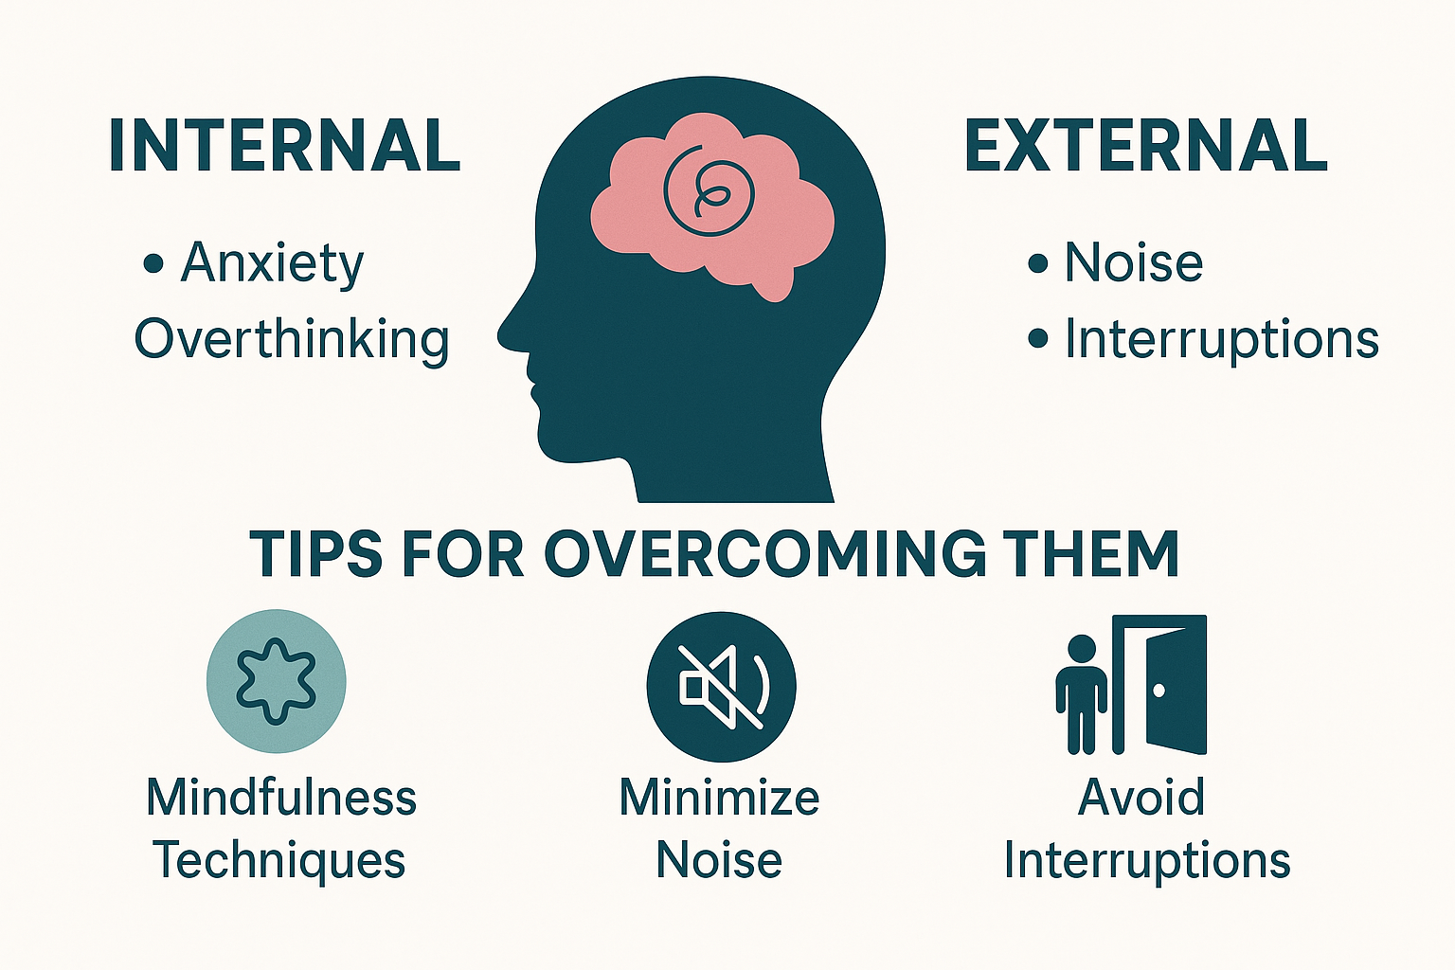
FUEL: Focus (Manage Distractions)
Internal: anxiety, overthinking → breathing, brief reset
External: noise, interruptions → environment setup
Mindfulness: quick grounding techniques

Slide 26
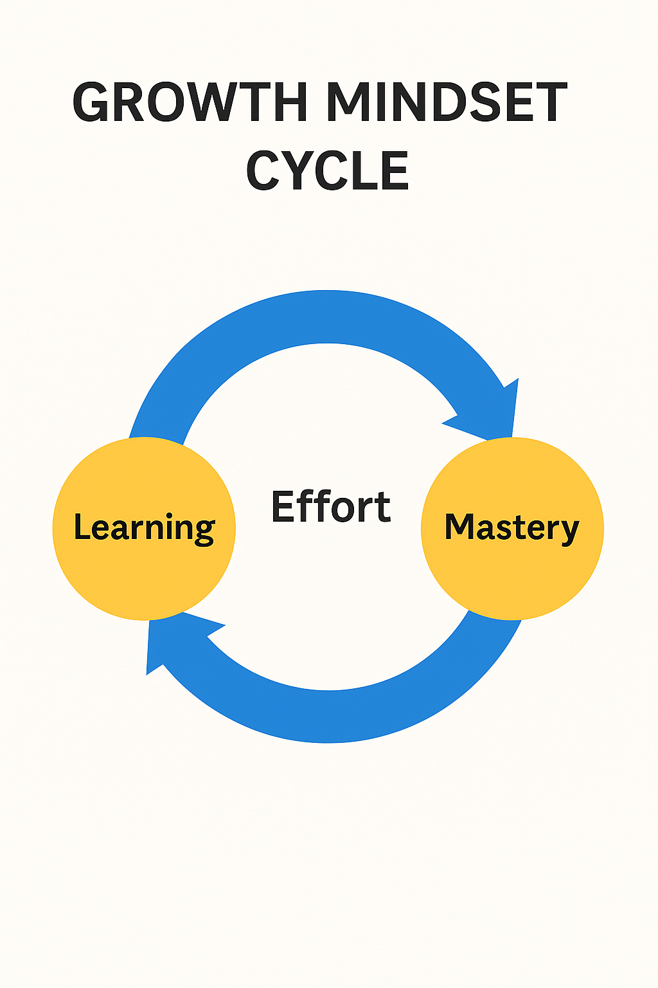
FUEL: Understand (Growth Mindset)
Treat mistakes as data.
Reflect → adjust plan → improve.

Slide 27
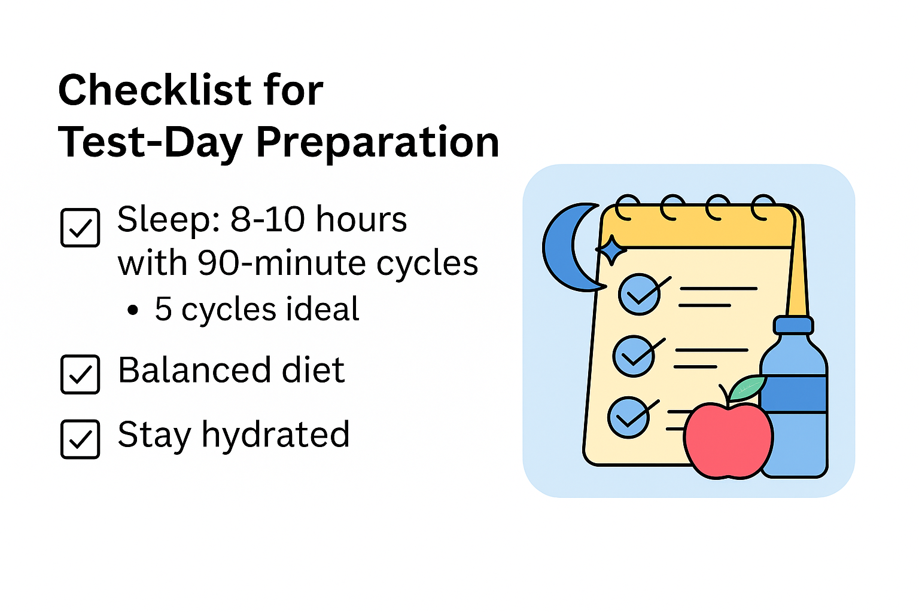
FUEL: Endure (Sleep & Nutrition)
Sleep: Aim 8–10 hrs (90-min cycles; ~5 cycles ideal).
Nutrition: Balanced meals leading up to test day.
Hydration: Consistent, not just test morning.

Slide 28

FUEL: Lead with Motivation (Metacognition)
Connect to Goals: admissions, scholarships, options.
Metacognition: plan → monitor → evaluate → revise.
Reflection Log: keep it current (weekly review).

Slide 29
FUEL Check (5 Qs)
How can you manage external distractions?
Why is a growth mindset useful?
Recommended sleep range for test performance?
Why reflect on practice tests?
Role of positive self-talk?
Notes:
Suggested answers: 1) Quiet space, minimize interruptions/noise 2) Helps learn from mistakes and improve 3) 8–10 hours (90-min cycles) 4) Identify patterns → target improvements 5) Focus + reduced anxiety

Slide 30
Part 4: Conclusion and Wrap-Up
Time: 5 minutes
Notes:
Part 4 pacing: ~5 minutes total.

Slide 31
Final Test-Day Reminders
Bring admission ticket, valid ID, approved calculator, and pencils.
Arrive early, stay calm, trust your preparation.
Quick review the day before — don’t cram.

Slide 32
Recap of Key Strategies
Test Structure: R&W + Math breakdown; adaptive modules.
FUEL: Focus, Understand, Endure, Lead.
Preparation: Full-length practice, reflection logs, target weaknesses.

Slide 33
Quiz 4 — Final Quiz (5 Qs)
What items must you bring to the SAT?
How does the adaptive system work?
What does FUEL stand for?
How to use reflection logs effectively?
Why simulate exam-like conditions?
Notes:
Answers: 1) Admission ticket, valid ID, approved calculator, pencils 2) Module 2 adapts to Module 1 performance 3) Focus, Understand, Endure, Lead 4) Analyze mistakes, track patterns, plan improvements 5) Build stamina and reduce surprises on test day

